Slide 1

Analyze Customers Reviews Based on Ratings And Recommendation
By Ayman Mohamed

Slide 2
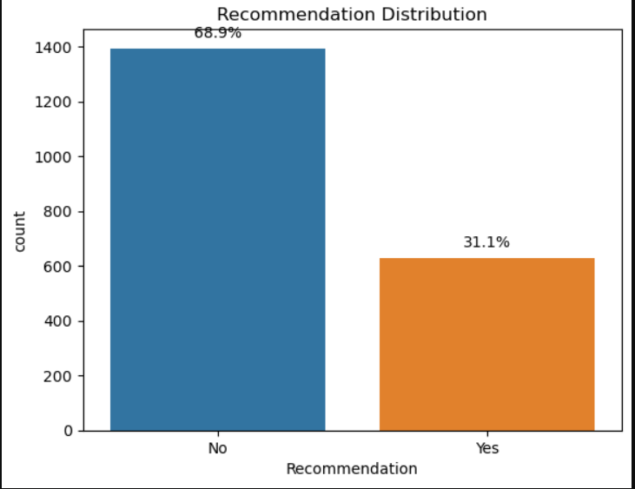
After Analysis: 68.9% of customers Recommend BA
31.1 % Not Recommended BA for other
so why?

Slide 3
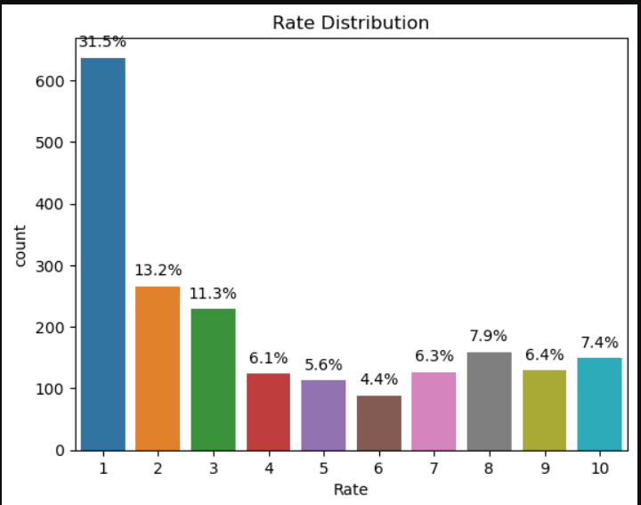
After Analysis: 31.5% of customers Rate 1 and it’s very high percentage

Slide 4
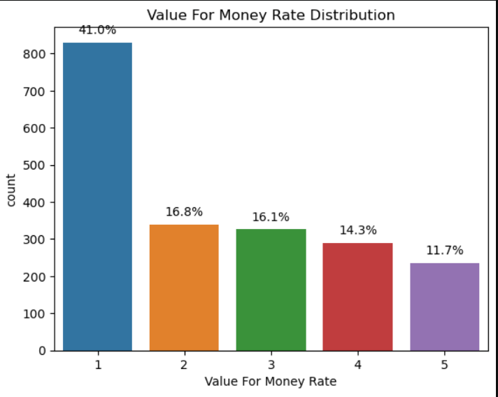
After Analysis:
We get 41% of customers gave rating 1 in value for money
Against 11.7% gave 5
So the customer not satisfied about service for money

Slide 5
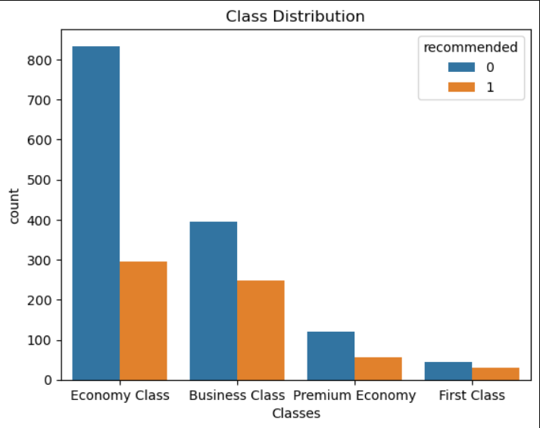
After Analysis:
We get more than 60% in each class not recommend BA for others

Slide 6
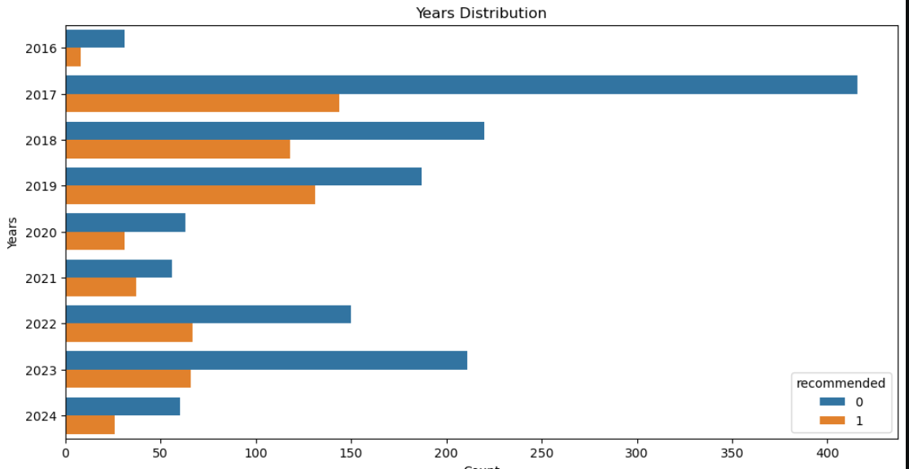
After Analysis: Each year not recommend rate more than recommend

Slide 7
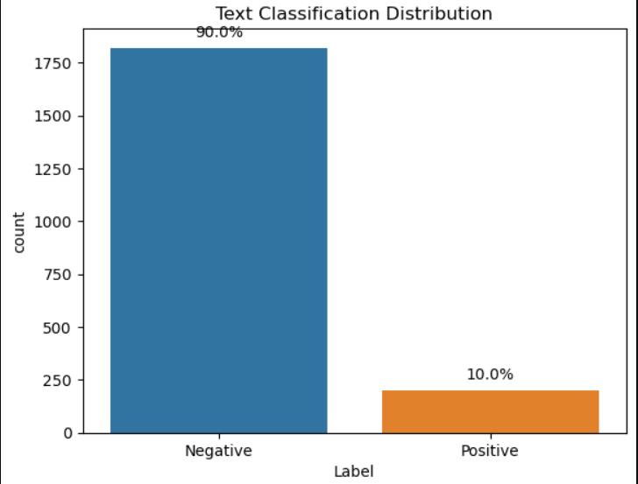
After Analysis Text Reviews:
90% of customers gave BA Negative Feedback.

